Slide 1
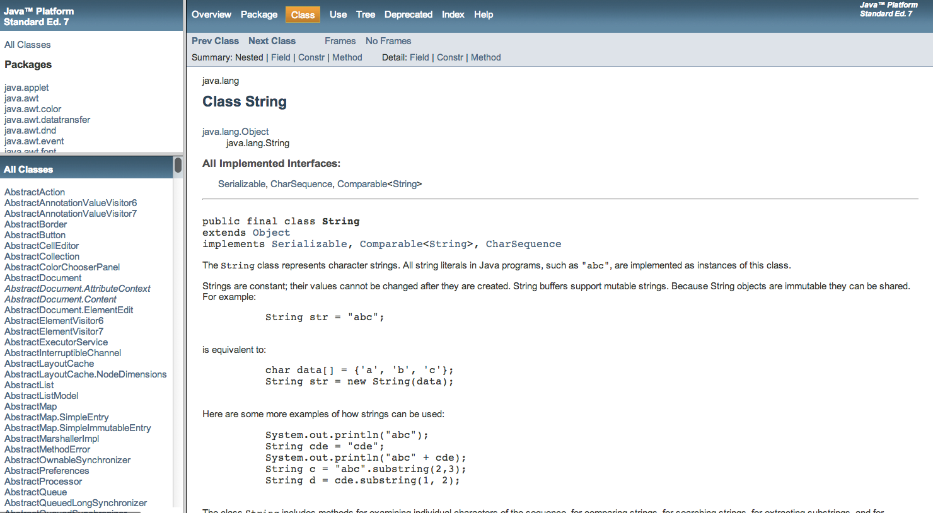

So we already know that java has A LOT of built in classes….

Slide 2
But, Wow – we can also make our own!!
This is where java gets really useful!
We have a real world problem that we need to solve….
So we can create the objects involved in the problem as java objects and just write code to get our solution!
Chapter 3 is going to teach us how to do this.
3.1 is starting to teach you how to represent attributes of your real world object
For example:
A door would have a color, a height, a width, etc
A car would have a make, model, year etc
These are all attributes and would be represented as: Instance Variables
private String doorColor = new String(“blue”);
private int carYear = 1967;

Slide 3
Instance Variables are a bit different
We are used to declaring variables, correct?
We learned this in section 2.2
dataType varName = value; //Universal Format for a primitive like int
int count = 0; //example
ObjectType varName = new ObjectType(…); //Universal format for a Java Object
String myName = new String(“Sharon”);
We declare Instance Variables (the attributes of our objects) nearly the same way except:
we typically only declare – and don’t initialize (slide 4)
they have a specific place in our program (slide 5)
we add an access modifier to the front (slide 6 & 7)

Slide 4
Declaring and Initializing Variables …a Review
From Section 2.2, Syntax 2.1 top of page 37
Recall that we can declare and initialize variables all in one step or just declare and use later.
Declare and initialize:
String greeting = new String(“hello”);
OR
Just declare:
private String greeting;
Then use later:
greeting = new String(“hello”);

Slide 5
Instance Variables – a different place
public class Counter
{
private int value;
…
public static void main(String[] args){
…
}
}

Slide 6
Instance Variables Format
Primitive Instance variables
//Universal Format for a primitive like int
private dataType varName; //declared instance variable
private int year; //example instance variable for Car Object

Slide 7
Instance Variables Format
Object Instance variables
//Universal Format for a java Object like string
private ObjectType varName;
private String carModel; //instance variable for Car Object

Slide 8
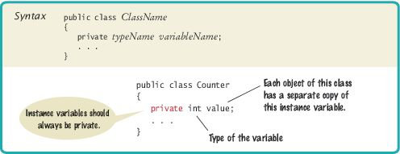
Syntax 3.1 Instance Variable Declaration

Slide 9
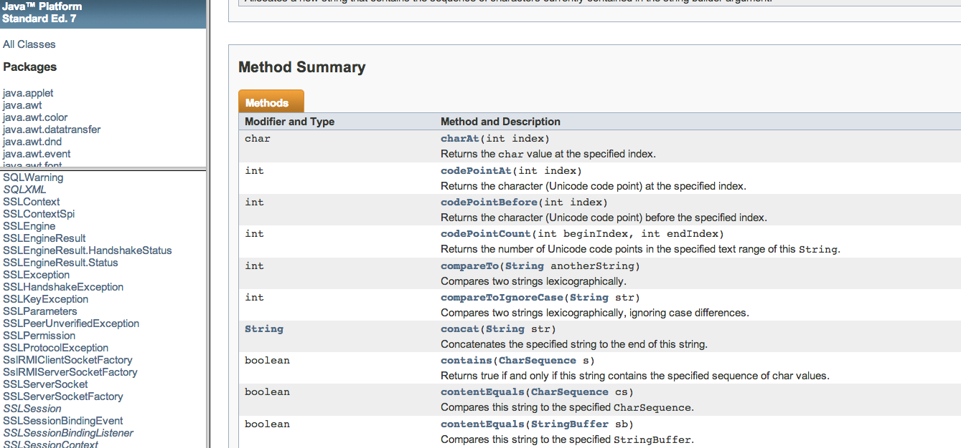
Methods
Recall that all of our java objects that we have been using have built in methods that we can call to manipulate the object

Slide 10
The Methods of the Counter Class
For now we will just talk about getters (accessors) and setters (mutators) (section 2.5)
Method declarations were covered in section 2.3.4
The getValue method returns the current value:
public int getValue()
{
return value;
}
The return statement
Terminates the method call
Returns a result (the return value) to the method's caller

Slide 11
The Methods of the Counter Class
The setValue method updates the current value:
public void setValue(int newValue)
{
value = newValue;
}

Slide 12
Encapsulation
Encapsulation is the process of hiding implementation details and providing methods for data access.
To encapsulate data:
Declare instance variables as private and
Declare public methods that access the variables

Slide 13
section_1/Counter.java
1 /**
2 This class models a tally counter.
3 */
4 public class Counter
5 {
6 private int value;
7
8 //GETS THE CURRENT CONTENTS OF value
9 public int getValue() {
10
11 return value;
12 }
13
14 //SETS THE CURRENT CONTENTS OF value TO inputValue
15 public void setValue(int inputValue){
16 value = inputValue;
17 }
18
19 public static void main(String[] args){
20 }
21 }

Slide 14
section_1/Counter.java
17 /**
18 Advances the value of this counter by 1.
19 */
20 public void click()
21 {
22 value = value + 1;
23 }
24
25 /**
26 Resets the value of this counter to 0.
27 */
28 public void reset()
29 {
30 value = 0;
31 }
32 }

Slide 15
Car.java
1 /**
2 This class models a car.
3 */
4 public class Car
5 {
6 private int year;
7 private String make;
8
9 //GETS THE CURRENT CONTENTS OF year
10 public int getYear() {
11 return year;
12 }
13 //GETS THE CURRENT CONTENTS OF make
14 public String getMake() {
15 return make;
16 }
17 //SETS THE CURRENT CONTENTS OF year TO inputYear
18 public void setYear(int inputYear){
19 year= inputYear;
20 }
21 //SETS THE CURRENT CONTENTS OF make TO inputMake
22 public void setMake(String inputMake){
23 make= inputMake;
24 }
25 public static void main(String[] args){
26 }
27 }

Slide 16
Self Checks and Message : Upload to BB: “I would like to code the object….” Where you fill in the name of a real world object you would like to write the code for. Now go on and do the self checks…

Slide 17
Self Check 3.2
Suppose you use a class Clock with private instance variables hours and minutes. How can you access these variables in your program?
Answer: You can only access them by invoking the methods of the Clock class.
For example:
Clock myClock = new Clock();
int hours = myClock.getHours();
int minutes = myclock.getMinutes();

Slide 18
Self Check 3.4
In Chapters 1 and 2, you used System.out as a black box to cause output to appear on the screen. Who designed and implemented System.out?
Answer: The programmers who designed and implemented the Java library.

